Slide 1
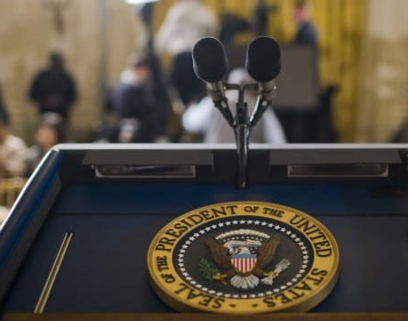
The Voice of
US Presidents
The message, sentiment, and sophistication of words in presidential history

Slide 2
Table of Contents
1
2
3
4
Overview & Objective
Workflow
Findings
Future Opportunities

Slide 3
Overview & Objective

Slide 4
Words matter.
"Speech is power: speech is to persuade, to convert, to compel.”
Ralph Waldo Emerson

Slide 5
We want to understand Presidents’ use of a speech’s power.
Examining:
Sentiment
Sophistication of words
Focus of content
Looking for trends, patterns, and tactics.

Slide 6
Workflow

Slide 7
Google Cloud Platform
Data
Pre-processing
‘Starting Point’
Analysis
Topic Modeling
‘Readability’ Analysis
Regex
Stopwords
Lemmatization
CountVectorizer
Word clouds
‘Top words’
Sentiment analysis
CountVectorizer, TFIDF
LSA, NMF, & LDA w/Gensim
stopwords, max_df, min_df, n_grams
Topic Creation & Selection
Readability Score analysis
(sophistication of words)
Pulling it all together for visualization & analysis! >

Slide 8
Google Cloud Platform
Data
Pre-processing
‘Starting Point’
Analysis
Topic Modeling
‘Readability’ Analysis
Regex
Stopwords
Lemmatization
CountVectorizer
Word clouds
‘Top words’
Sentiment analysis
CountVectorizer, TFIDF
LSA, NMF, & LDA w/Gensim
stopwords, max_df, min_df, n_grams
Topic Creation & Selection
Selected model:
CountVectorizer
LDA w/Gensim
custom stopwords, max_df=0.8, Min_df=0.1, bigrams
Readability Score analysis
(sophistication of words)
Pulling it all together for visualization & analysis! >

Slide 9
Findings

Slide 10
Findings: Sentiment

Slide 11
But first...a caveat.
The
‘Negative - Positive’
label in sentiment analysis

Slide 12
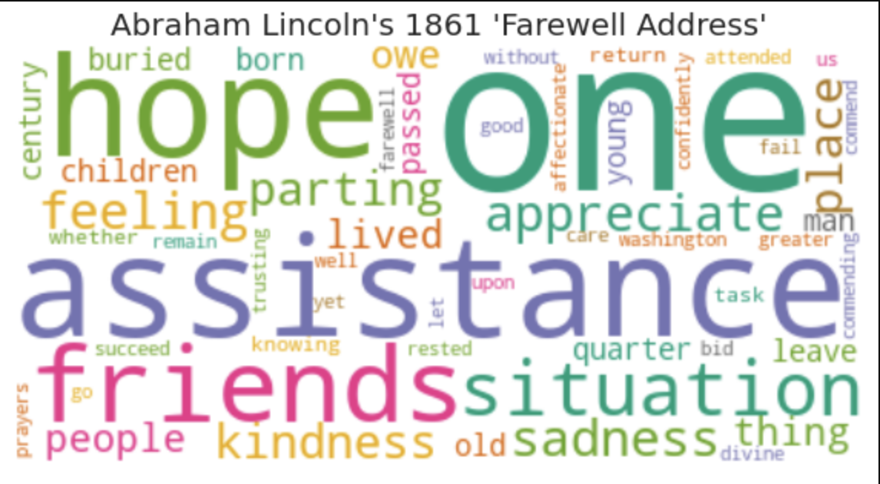
The most ‘negative’ speech in this analysis:

Slide 13
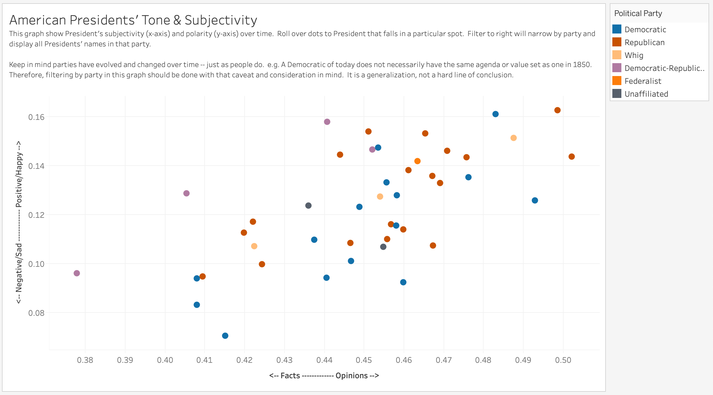

Slide 14
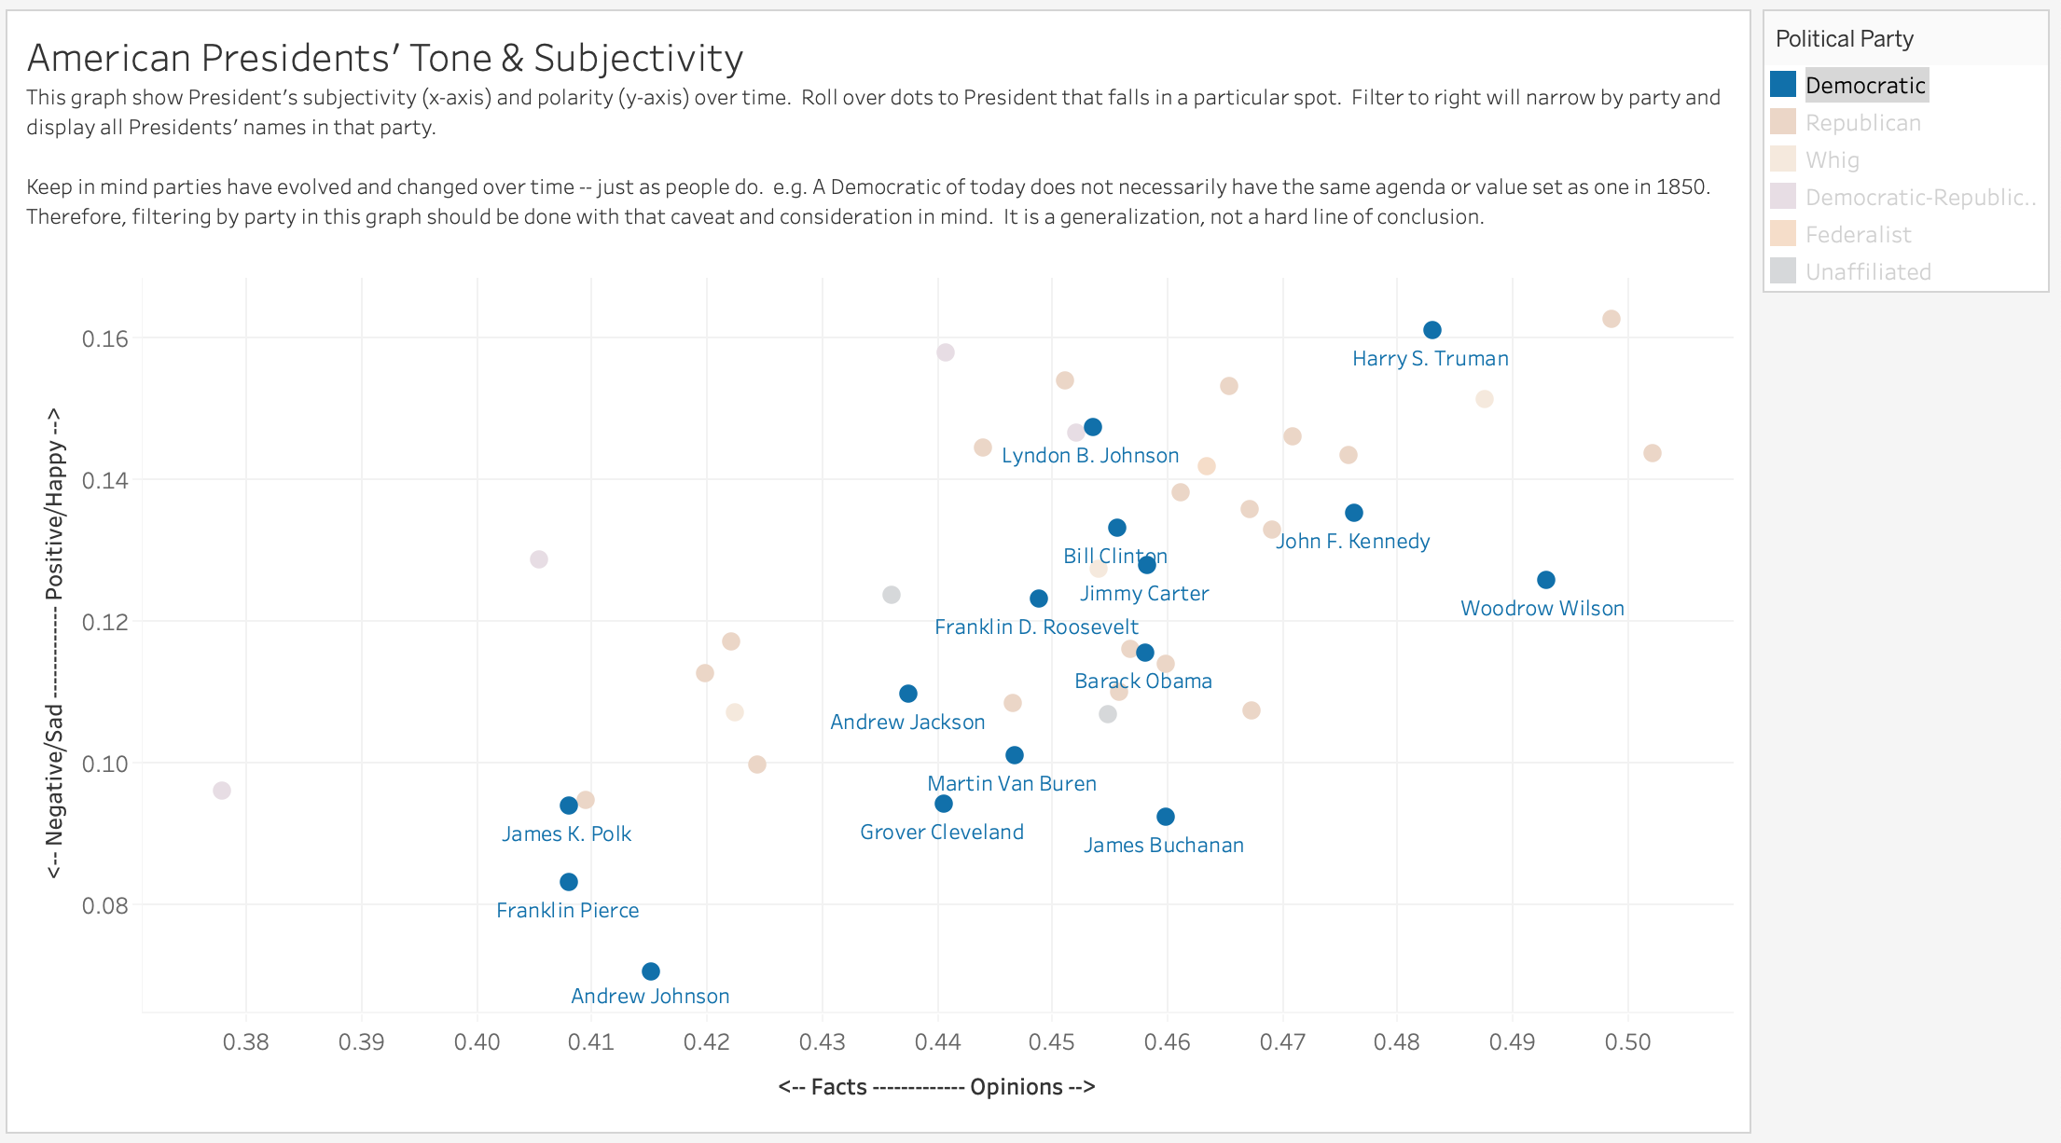

Slide 15
Findings: Sophistication of Words

Slide 16
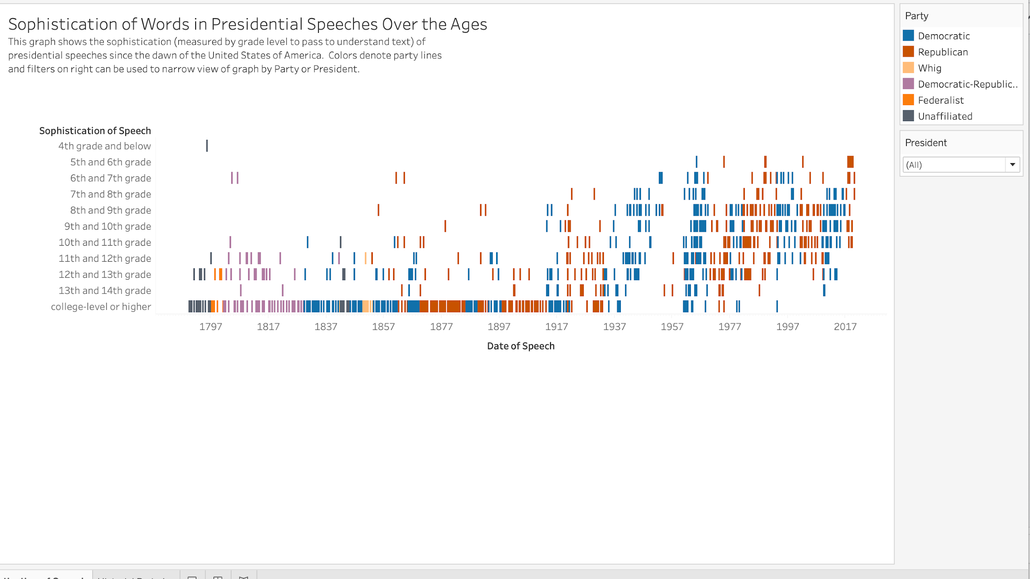

Slide 19
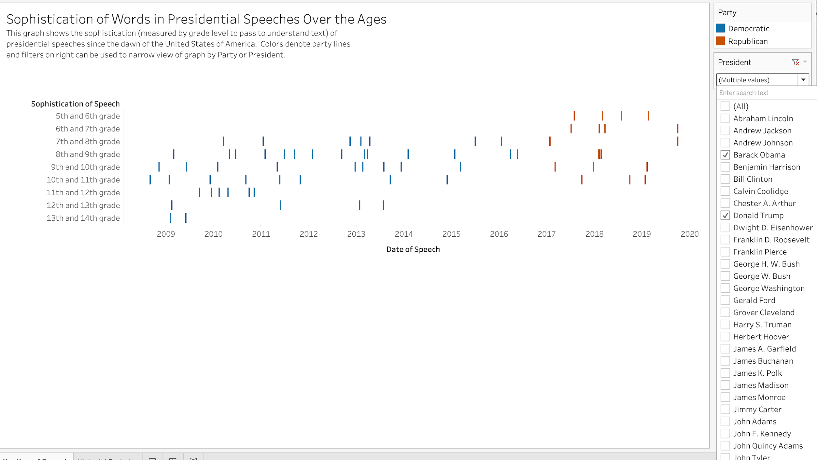
Donald Trump
Barack Obama

Slide 20
Findings: Topics of Speeches

Slide 21
Topics of Speeches:
American jobs and family help & needs
Law, constitution, and rights
Laws, treaties, and action
Public power & duty
War with American freedom
Work & business
World peace with war & force

Slide 22
Topics of Speeches:
American jobs and family help & needs
Law, constitution, and rights
Laws, treaties, and action
Public power & duty
War with American freedom
Work & business
World peace with war & force

Slide 23
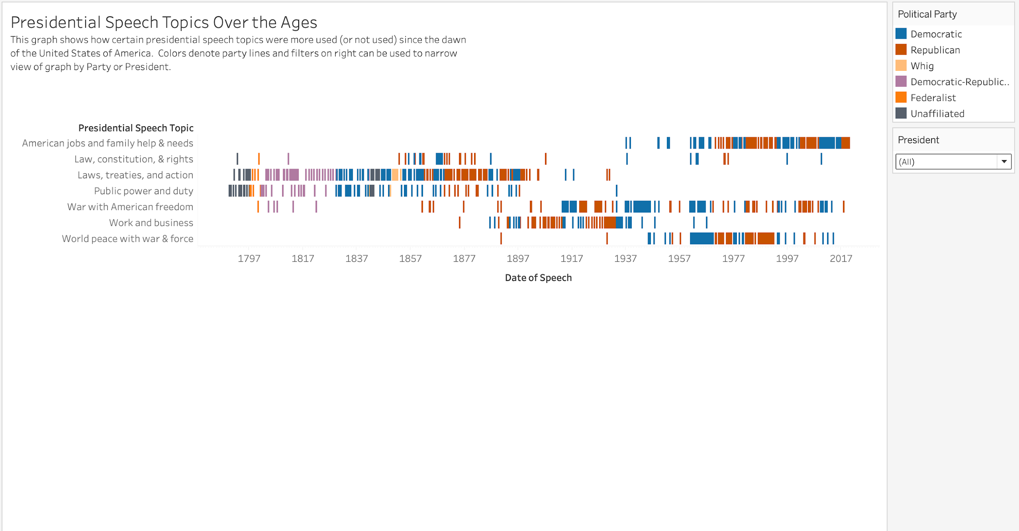

Slide 26
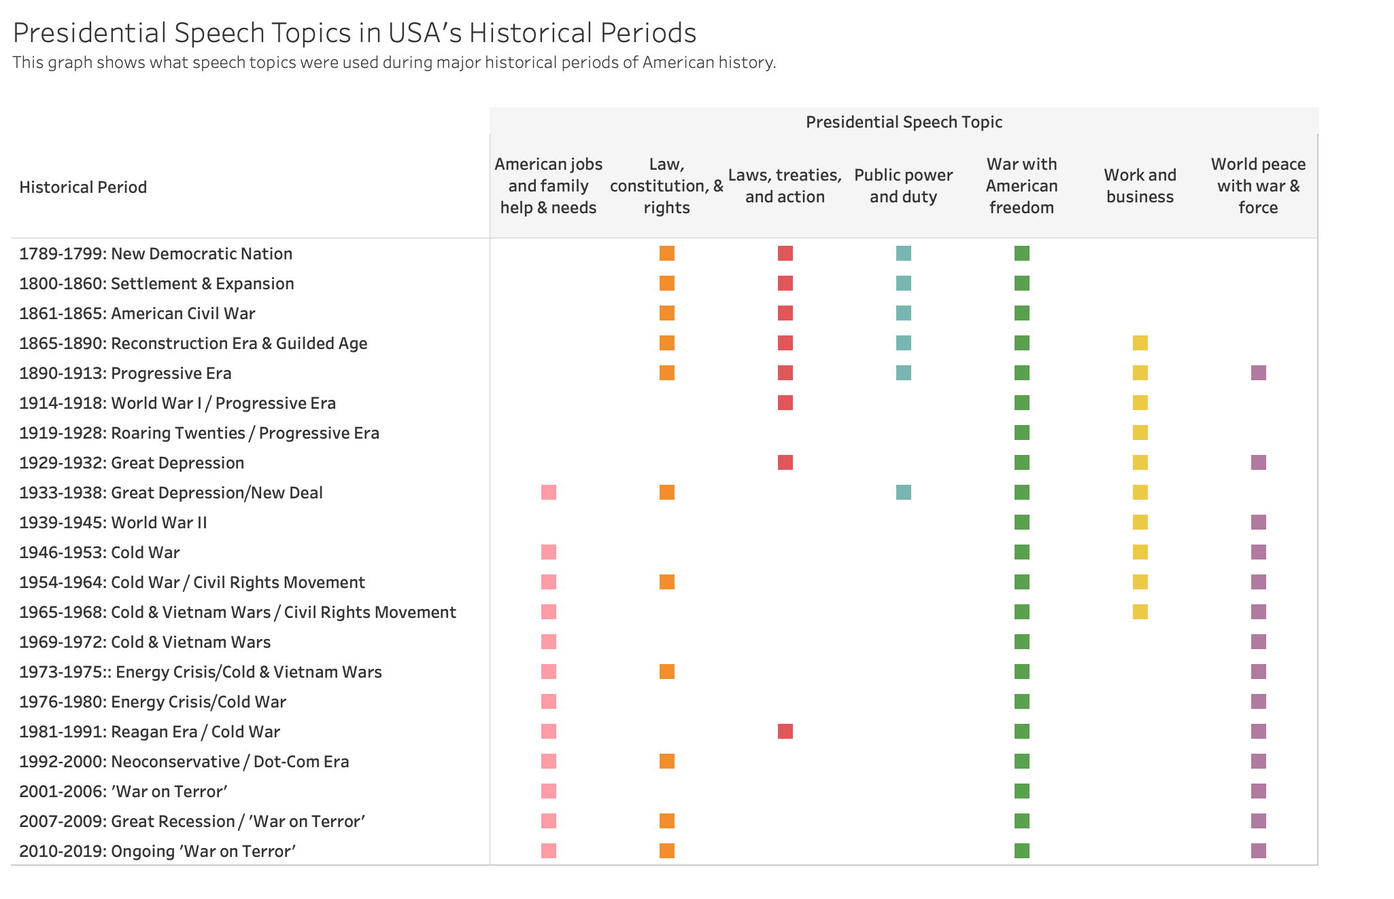

Slide 29
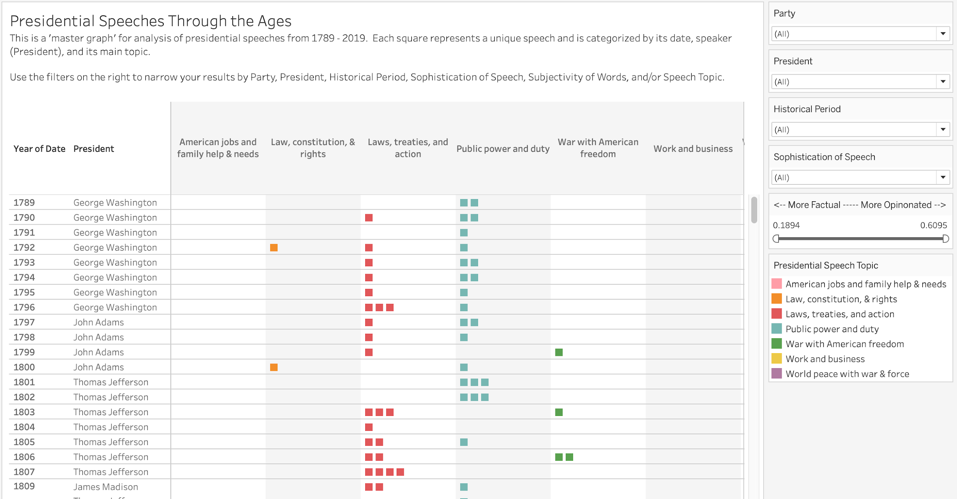

Slide 30
Summary of Findings:

Slide 31
Summary of Findings:
Sentiment of individual speeches is very situational-dependent.

Slide 32
Summary of Findings:
Sentiment of individual speeches is very situational-dependent.
Sentiment seems to vary by person, not necessarily party.

Slide 33
Summary of Findings:
Sentiment of individual speeches is very situational-dependent.
Sentiment seems to vary by person, not necessarily party.
-
‘Sophistication’ of words in speeches has trended down over years --
potentially to be more relatable as more people heard the speeches.

Slide 34
Summary of Findings:
Sentiment of individual speeches is very situational-dependent.
Sentiment seems to vary by person, not necessarily party.
-
‘Sophistication’ of words in speeches has trended down over years.
potentially to be more relatable as more people heard the speeches.
-
Topics of speeches vary more over the years vs by political party.

Slide 35
Summary of Findings:
Sentiment of individual speeches is very situational-dependent.
Sentiment seems to vary by person, not necessarily party.
-
‘Sophistication’ of words in speeches has trended down over years.
potentially to be more relatable as more people heard the speeches.
-
Topics of speeches vary more over the years vs by political party.
Topics of speeches seem to carry relationship with state-of-nation
and historical periods may also be the catalyst for a shift in tone for generations.

Slide 36
Summary of Findings:
Sentiment of individual speeches is very situational-dependent.
Sentiment seems to vary by person, not necessarily party.
-
‘Sophistication’ of words in speeches has trended down over years.
potentially to be more relatable as more people heard the speeches.
-
Topics of speeches vary more over the years vs by political party.
Topics of speeches seem to carry relationship with state-of-nation
and historical periods may also be the catalyst for a shift in tone for generations.

Slide 37
Future Opportunities

Slide 38
Pair with American historian for deeper insights
and examination
Examine evolution of meaning & context words over time, such as:
Rights
Duty
International Countries
Women

Slide 39
A Woman’s Voice
50.8%
of US population

Slide 40
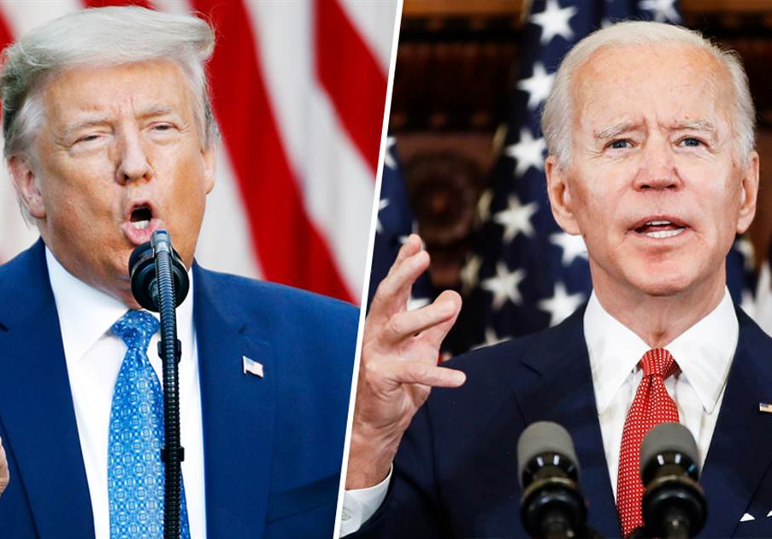
Thank you
Do you have any questions?
Email: celinaplaza@gmail.com
LinkedIn: linkedin.com/in/celinaplaza
Website: celinaplaza.org
CREDITS: This presentation template was created by Slidesgo, including icons by Flaticon, infographics & images by Freepik and illustrations by Stories

Slide 41
APPENDIX

Slide 42
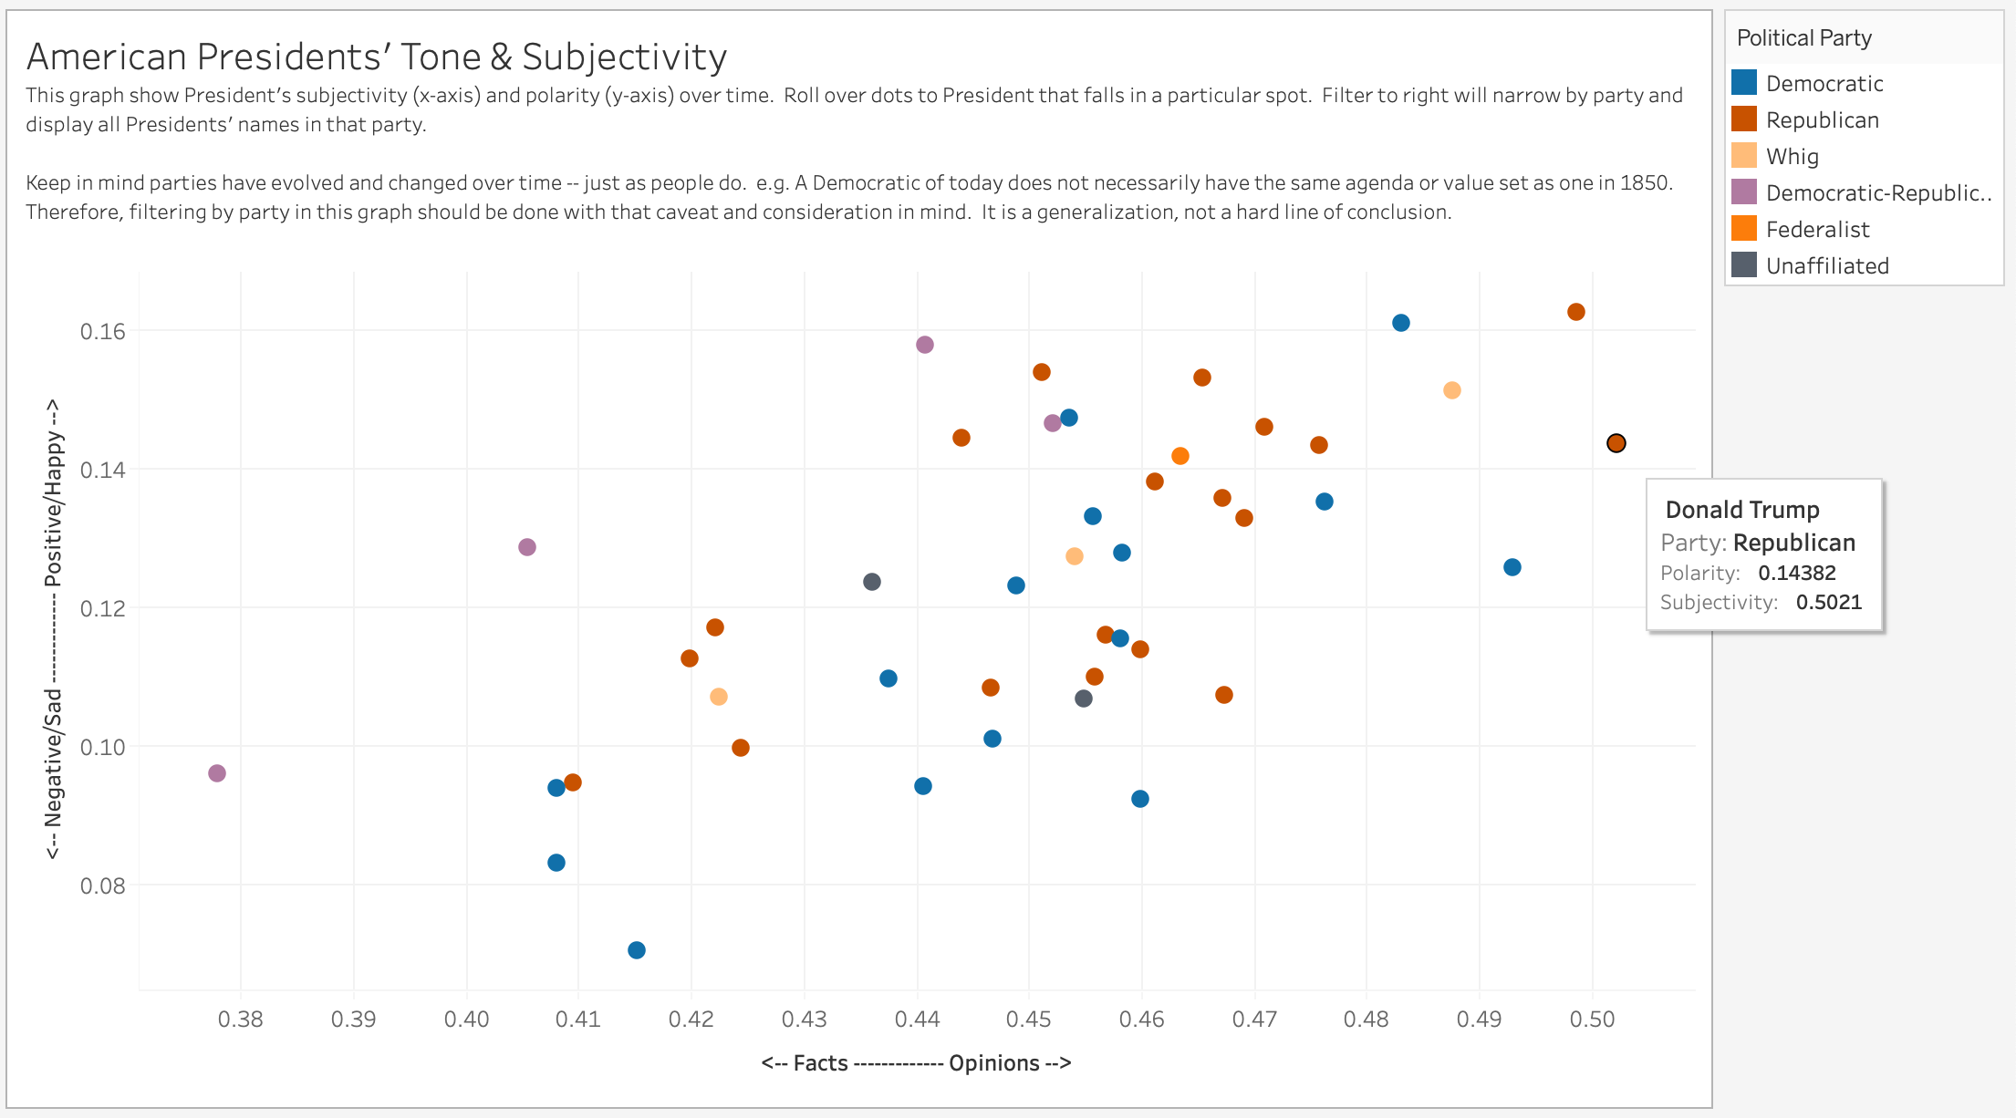

Slide 43
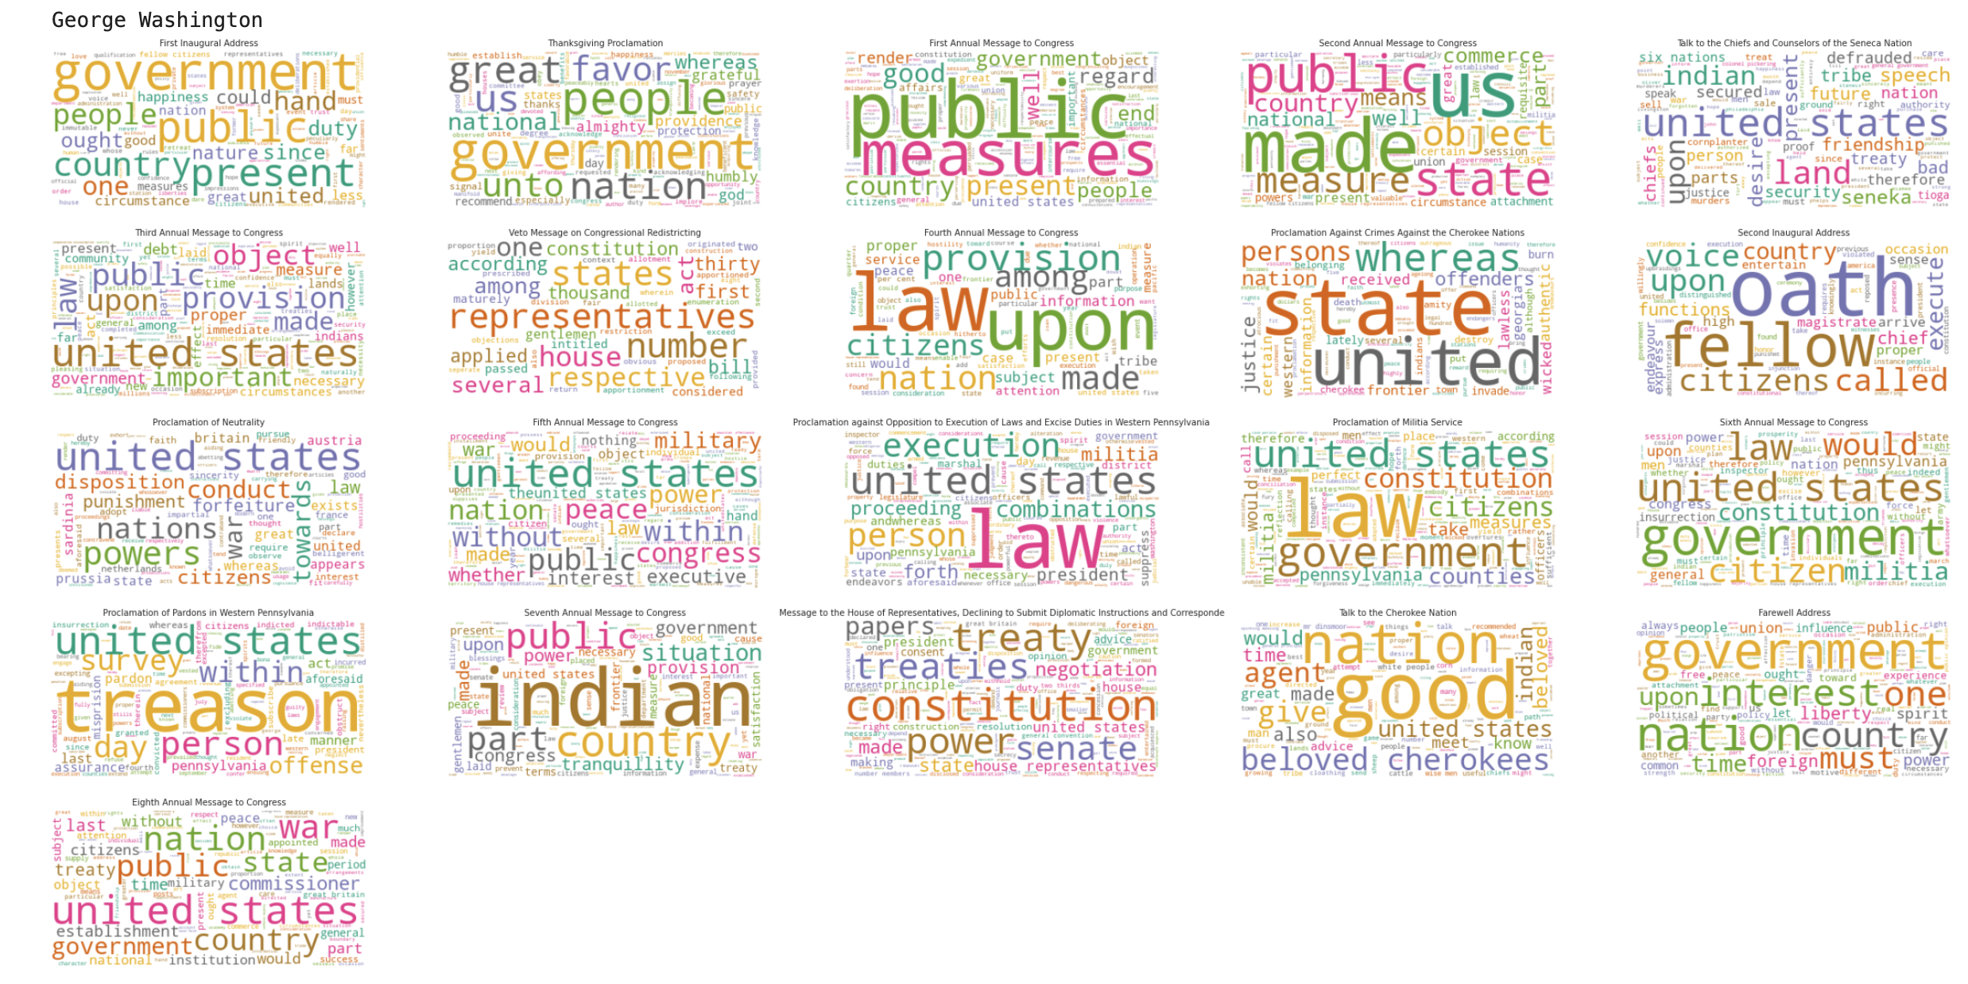
Wordclouds for George Washington’s speeches

Slide 44
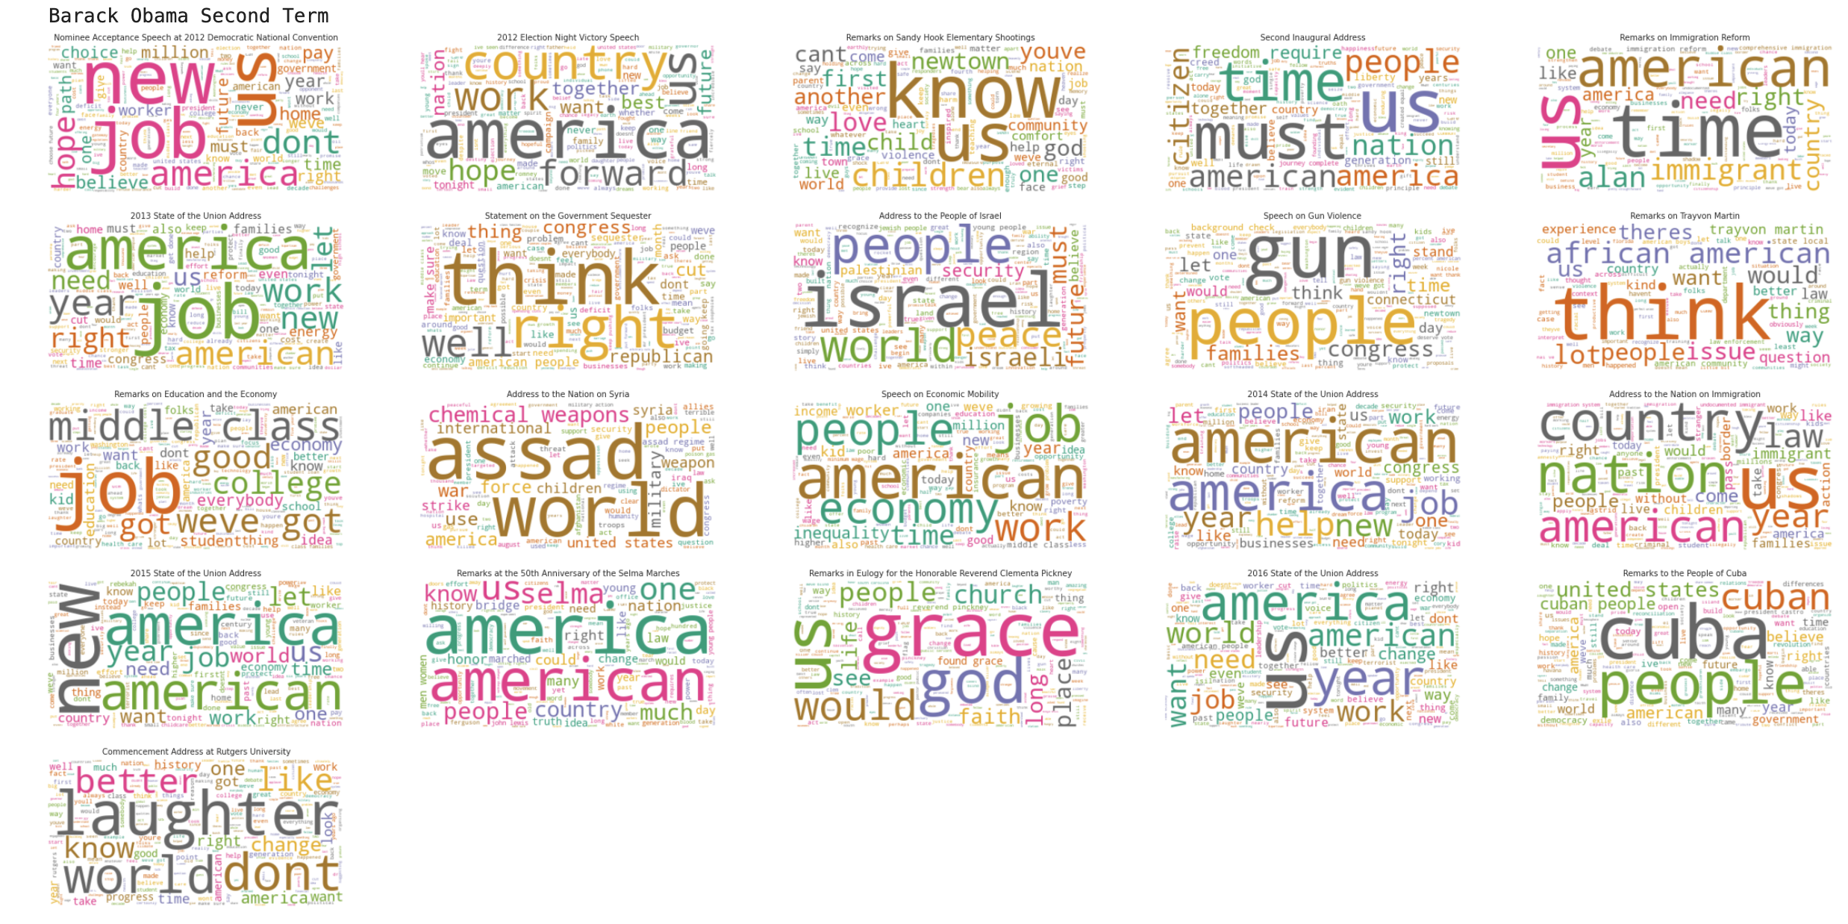
Wordclouds for Barack Obama’s speeches

Slide 45
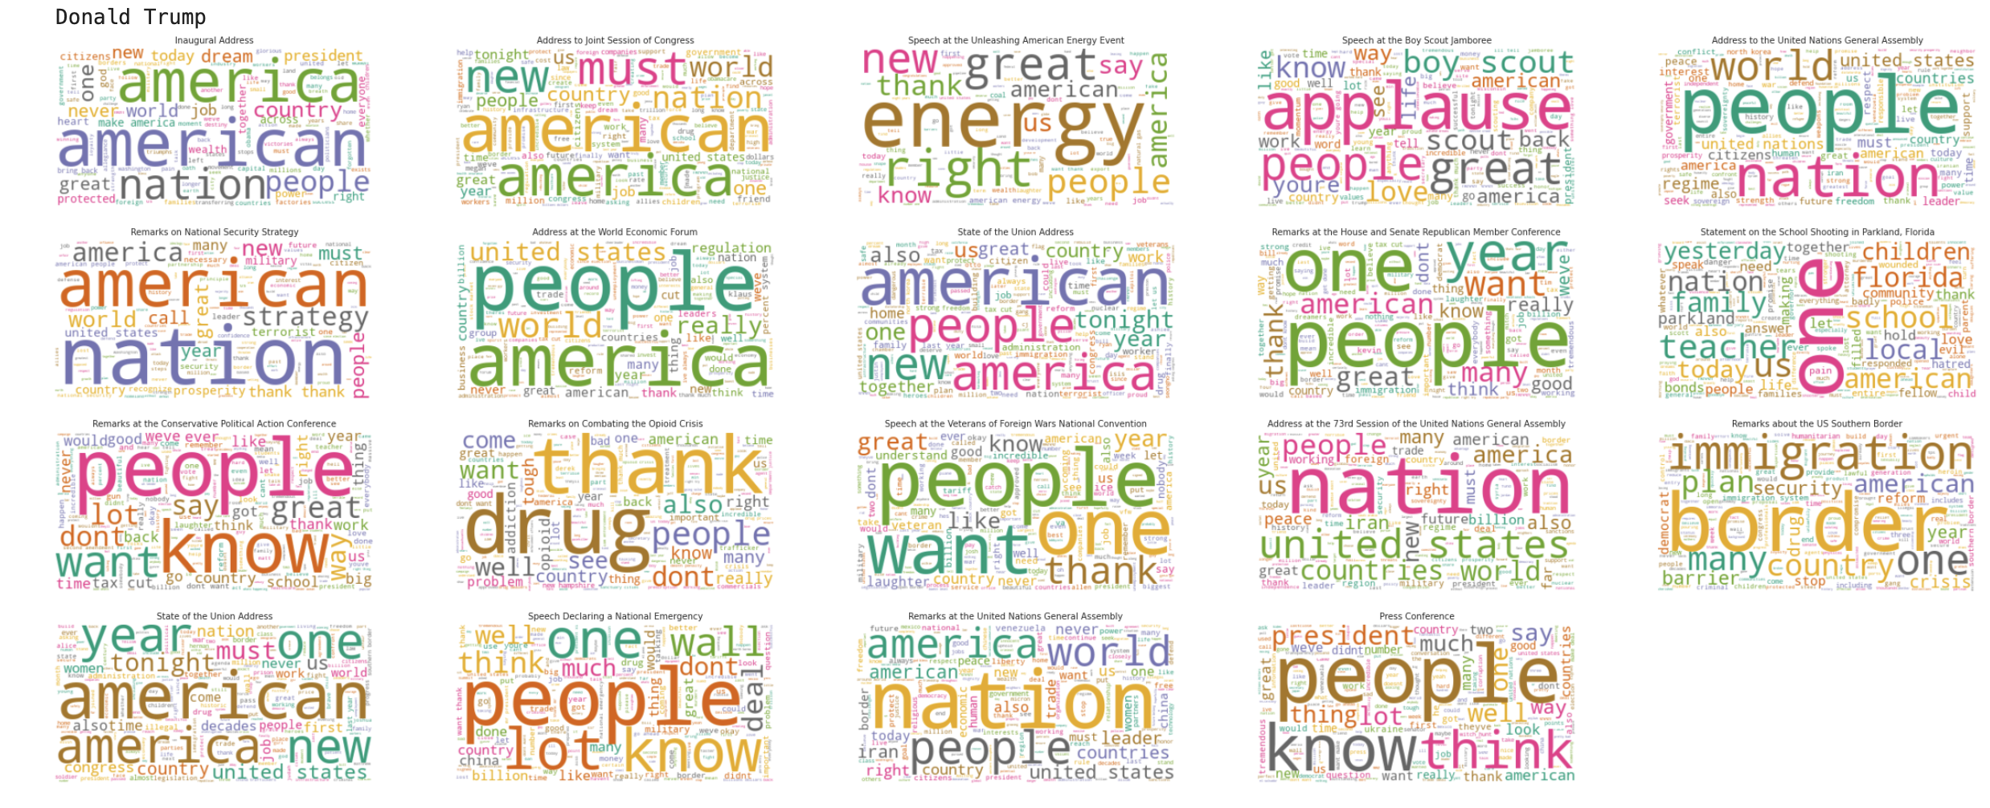
Wordclouds for Donald Trump’s speeches

Slide 46
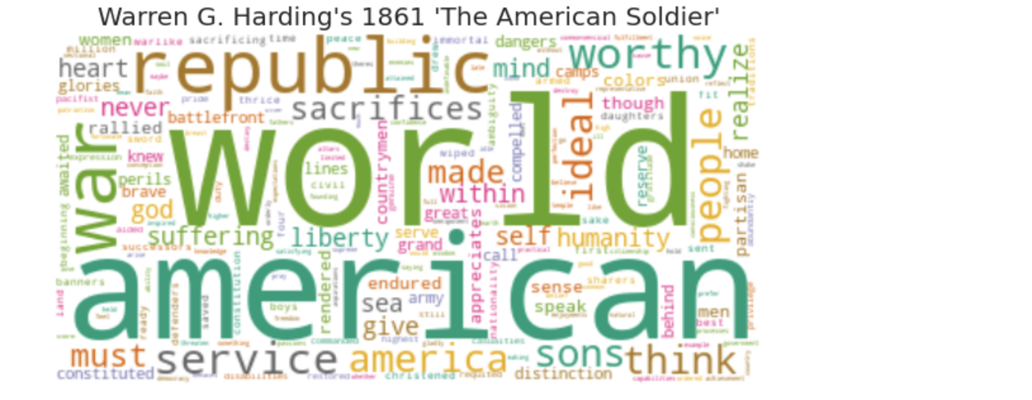
Wordcloud for ‘most subjective’ speech

Slide 47
Words within speech topics (1 of 2):
Law, constitution, and rights
0.018*"law" + 0.015*"constitution" + 0.015*"right" + 0.013*"question" + 0.010*"congress" + 0.009*"house" + 0.008*"election" + 0.008*"slavery" + 0.008*"act" + 0.007*"union"
World peace with war & force
0.014*"world" + 0.013*"peace" + 0.009*"vietnam" + 0.009*"american" + 0.009*"soviet" + 0.009*"war" + 0.007*"force" + 0.007*"new" + 0.006*"military" + 0.006*"security"
War with American freedom
0.019*"world" + 0.016*"war" + 0.013*"american" + 0.012*"peace" + 0.012*"men" + 0.010*"life" + 0.009*"america" + 0.009*"freedom" + 0.007*"right" + 0.007*"free"
Work & business
0.009*"law" + 0.008*"congress" + 0.008*"work" + 0.007*"business" + 0.006*"service" + 0.006*"public" + 0.006*"national" + 0.006*"american" + 0.005*"commission" + 0.005*"legislation"'

Slide 48
Words within speech topics (2 of 2):
American jobs and family help & needs
0.017*"american" + 0.013*"america" + 0.010*"new" + 0.009*"job" + 0.009*"work" + 0.007*"tax" + 0.007*"child" + 0.007*"world" + 0.006*"help" + 0.006*"need"
Public power & duty
0.016*"public" + 0.016*"power" + 0.009*"duty" + 0.009*"bank" + 0.008*"constitution" + 0.007*"congress" + 0.007*"law" + 0.007*"citizen" + 0.006*"union" + 0.006*"present"
Laws, treaties, and action
0.012*"congress" + 0.008*"law" + 0.008*"treaty" + 0.007*"act" + 0.007*"war" + 0.006*"duty" + 0.006*"citizen" + 0.006*"power" + 0.005*"territory" + 0.005*"public"

Slide 49
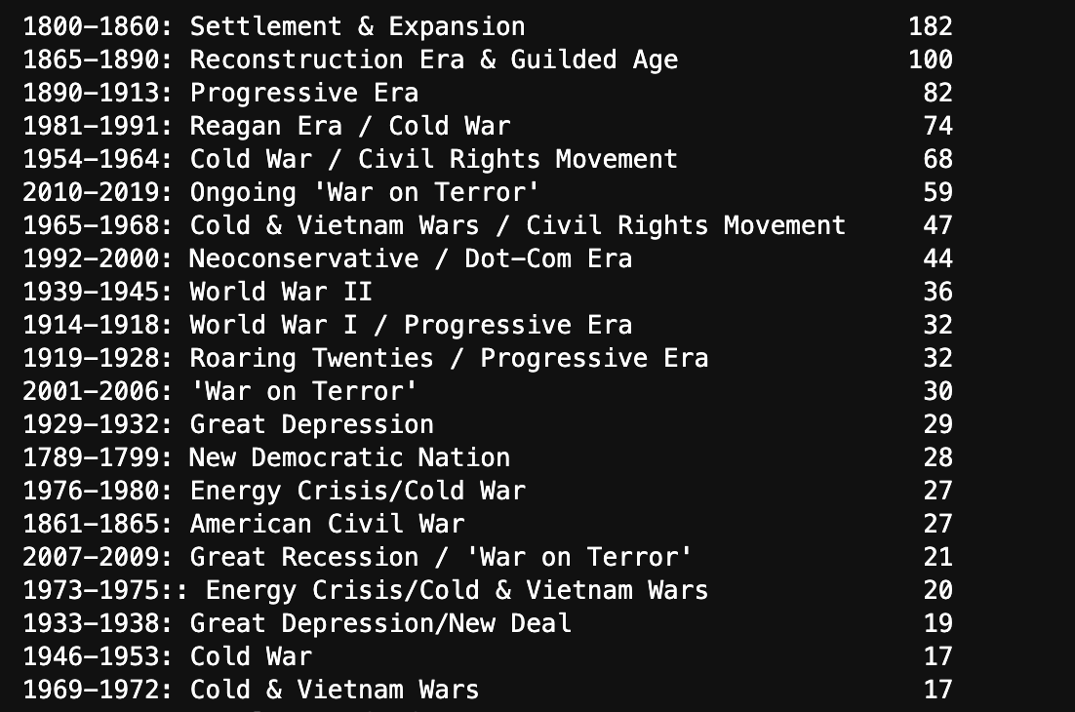
Number of speeches in each historical period

